Slide 1
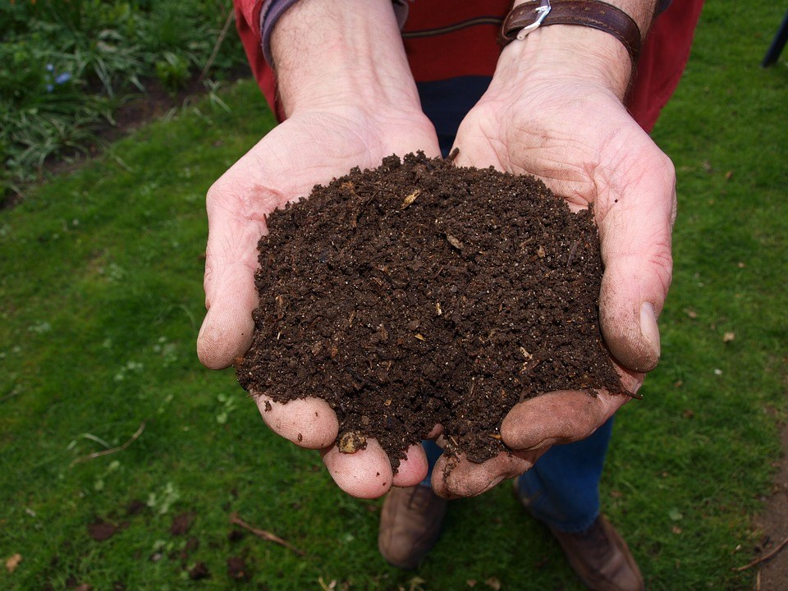
Composting Guide Sheet
Benefits
Decreases municipal collection and disposal cost
Decreases the amount of garbage → Decrease curb side garbage collection → Less collection required → Decreases cost
Prolong the life of landfill
Landfills are designed to keep air and moisture out, which are necessary for decomposition. Methane gas and leachate are produced when organics break down under these conditions, so putting less organic waste into the household trash
Improves soil quality and plant health by:
Retains moisture
Prevents erosion
Replenish nutrients in soil
Reduces the need to water gardens
Eliminates the need to purchase other fertilizers
It is FREE
What is composting?
Natural process of decomposition and recycling of organic material into humus (a rich soil additive)

Slide 2
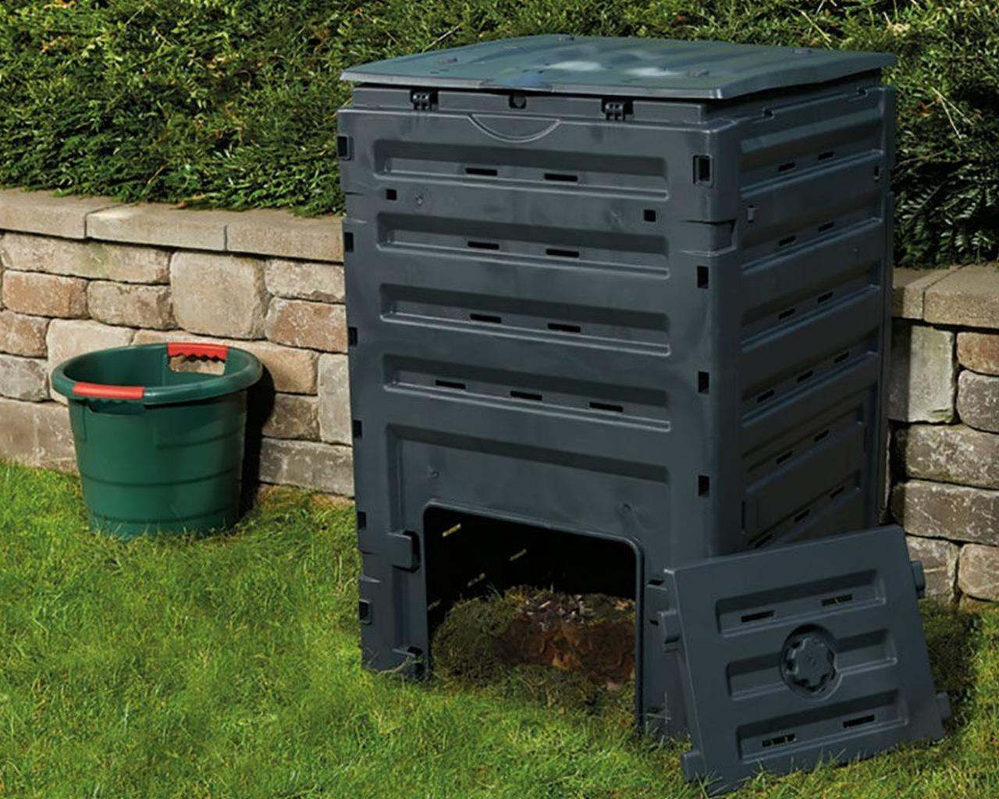
Compost bins
Compost bins are usually large black boxes made from plastic with a lid at the top to put in plant material and a small door at the bottom where the compost comes out.
Pros:
Large Capacity
Easy To Use
Premade
Cons:
Manual Mixing

Slide 3
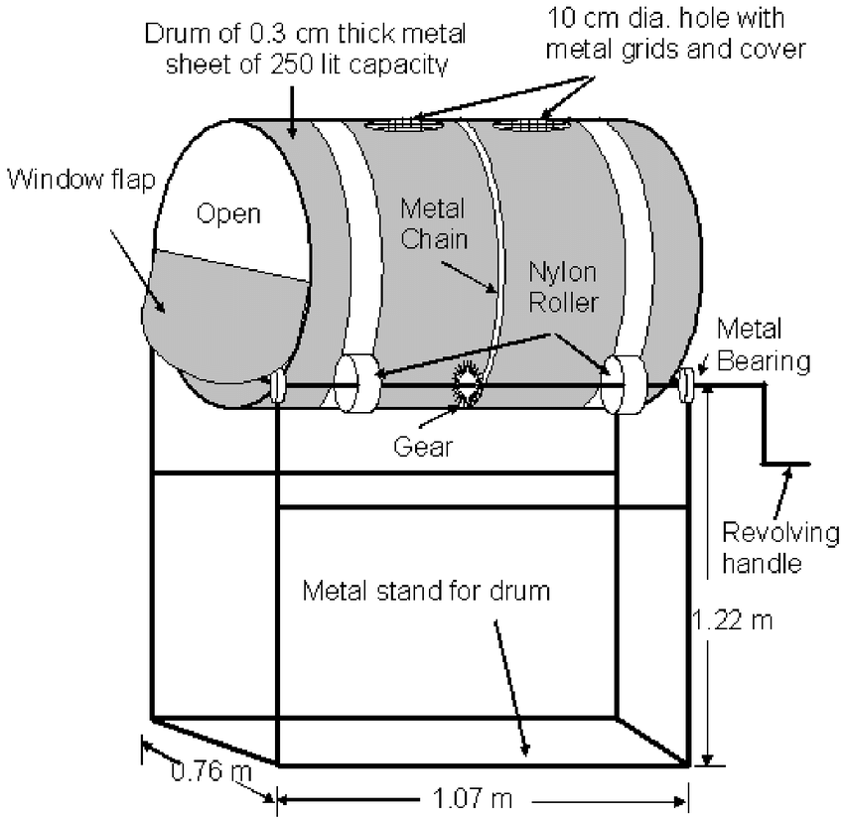
Rotating Composter
Rotating composters are made of black plastic and are similar to compost bins, but they spin to turn the compost over.
Turning over compost is important to keep air in it and to make sure it is mixed well.
Pros:
Easy to use
Easy to mix compost
Cons:
Need to introduce worms and bugs
Smaller capacity

Slide 4
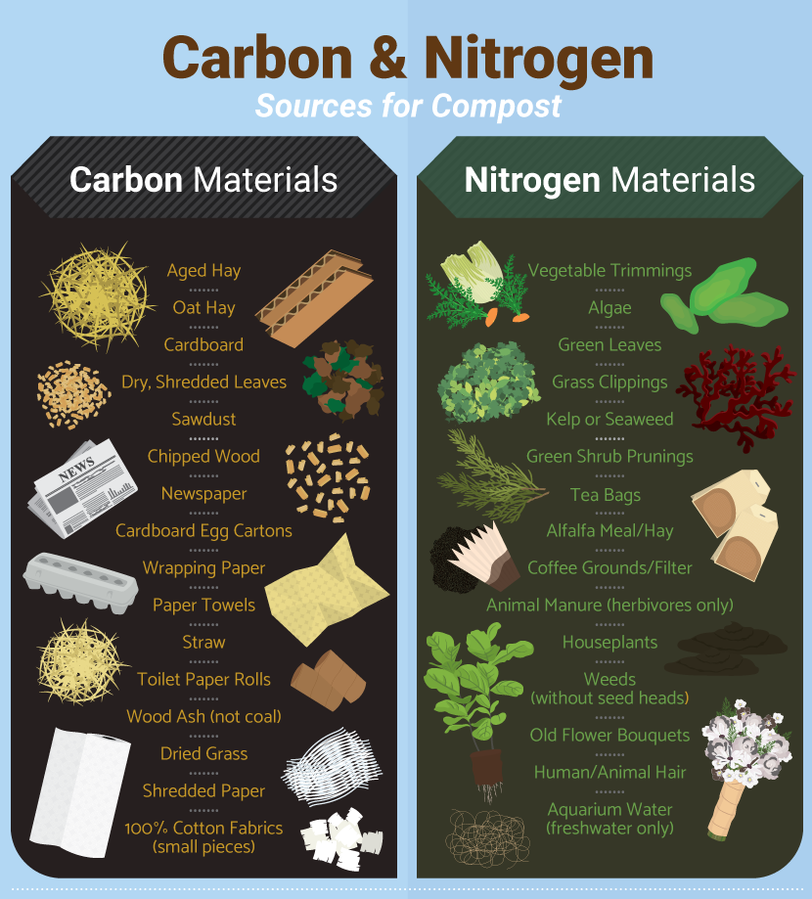
What Can Be Composted?
DO NOT COMPOST
Meat
Bones
Dairy products
Cooking oil
Invasive plants (e.g. Himalayan balsam, Japanese knotweed)
Human or pet wastes
Charcoal or coal ashes

Slide 5
How To Compost?
Setup
Composting can take place in a bin or a pile. Bins help keep the compost neatly contained and can keep animals and pests out.
Can purchase a composting bin or build one from wood or wire mesh.
The best place for the composter is in a convenient, sunny location on level ground with adequate drainage
.
Place a layer of sticks at the bottom of the composter to keep the pile aerated. Place 5 or 6 centimeters of small branches or twigs at the bottom of the composter and make a hole in the center (like a nest)
Put a layer of dead leaves, compost or earth. Preparing the bottom of the composter will allow for better aeration, stabilize humidity and prevent decomposing matter from compacting into the ground. Then alternate layers between browns and greens.
Avoid adding thick layers of any one type of waste
New materials should be placed in the center, which is the most active area of the pile, while partially decomposed materials should go on the outer edges of the pile
The process requires moisture and oxygen, so it is important to keep the pile moist and turn it regularly with a shovel or pitchfork
To finish composting sooner, stir it as often as every 3 to 5 days. Otherwise, turning every couple of weeks in warm weather will be sufficient

Slide 6
How To Maintain?
Compost needs air
Every 2-3 weeks, before adding new material, mix the pile with a compost turner, pitchfork, or other garden tool.
Garden stakes, pipes, or even simple holes poked with a broom handle can also help allow air into the pile.
An unmixed pile will compost very slowly and may create an unpleasant smell.
If aeration is not properly achieved, the materials will rot and start to smell
Compost needs water.
Humidity is key to bacteria development
Keep the pile about as moist as a well-wrung sponge
Do not forget to try to recycle and use harvested rainwater or leftover (non-dairy!) beverages.

Slide 7
Using Finished Compost
Finished compost should feel like a wrung-out sponge. When squeeze a handful of it, no more a couple drops of liquid should come out. It should be a dark brown colour and should have a pleasant earthy smell to it.
Wait until the pile is fully inactive before using the compost. The microbial activity generates heat, so when finished, the centre of the pile should no longer feel hot.
Can also screen out larger items that have not broken down (twigs, etc.), return them to the pile, and spread finished compost onto the lawn as a top dressing, no more than 1cm deep.
Finished compost can be used in many ways:
High in nutrients, it can be applied as desired to gardens, houseplants, hedges, and bushes.
You may wish to screen or sift your compost through wire mesh. Sifted compost can be used as potting mix and for starting seeds and plants. Sifted compost is also an excellent top dressing for lawns.
The woody leftovers or un-composted materials can be used as mulch or composted again.

Slide 8
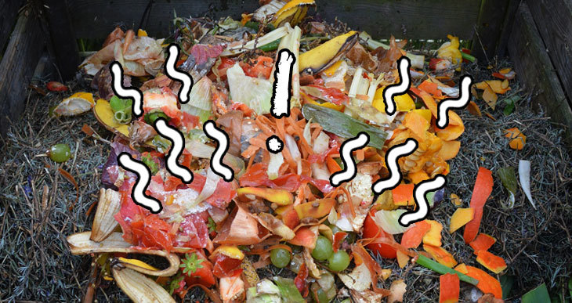
Odour
Possible Solutions
Mix in dry browns.
Turn the compost to add air.
Add some untreated wood ashes, sawdust, or shredded newspaper.
If drainage is a problem, building a plank floor can help.
If it smells like rotten eggs, turn the pile for several consecutive days until the smell is gone, and top the pile with soil or finished compost.
When adding new material, make a hole in the top of the pile, stir in the organics, and cover with dry ingredients such as leaves. Always try to have a layer of browns on top of the pile
Can also add soil at any stage of the layering process. A thin layer of soil added on the top of the pile also helps to discourage pests and prevent odours
Possible Causes
Not enough air
Too wet
Too compacted
Too many “greens”
Too much food waste

Slide 9
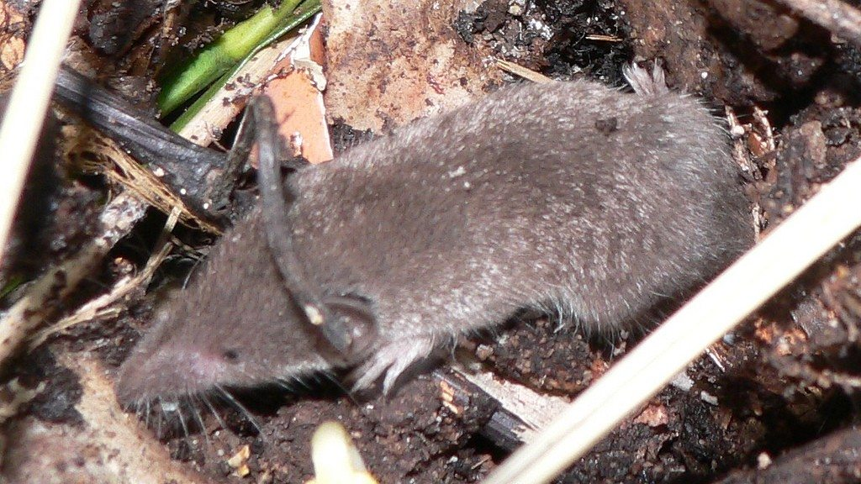
Animals And Pests Issues
Possible Solutions
Ensure the lid is closed and locked after adding and mixing materials
Always completely cover food residuals with a layer of browns, soil, or finished compost
Ensure that fats, oils, meats, seafood and dairy are excluded. Put only vegetable matter in your composter
A fine wire mesh under the compost bin will discourage vermin if necessary. Wrap the bottom of the composter in strong wire mesh (1/4 inch hardware cloth)
Move your composter out in the open, rather than close to a fence or shed. An open area makes rats more vulnerable to predators.
Visit your composter more often!
Possible Causes
Food residuals exposed
Bin unprotected
Notes
Critters like worms, centipedes, and other insects should appear in the composter to help the bacteria break down the material

Slide 10
Slow Composting
Possible Causes
Not enough greens
Not enough air
Not enough moisture
Possible Solutions
Add more greens, mix thoroughly, and ensure the pile is moist
Can also add soil at any stage of the layering process.
A shovel-full of soil will introduce many soil organisms into the pile and act as an accelerator

Slide 11
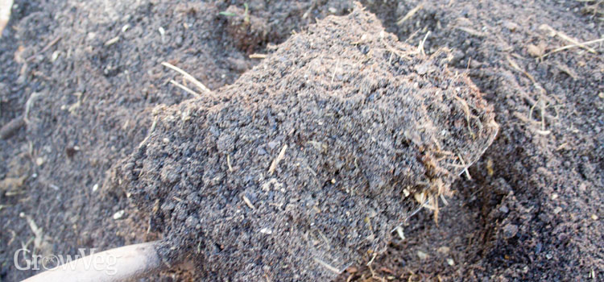
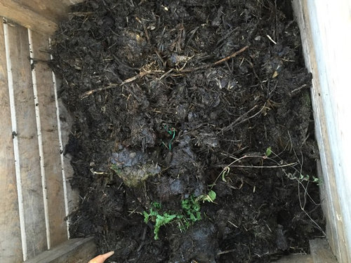
Humidity
If too dry
Dust appears when turned, it does not stick together when squeezed a handful
Add water or leave the lid open when it rains
If too wet
Add carbon-rich (“browns”) to absorb moisture

Slide 12
Why Compost?
Composting naturally supplements the nutrient content of existing soil
It can reduce food and other household wastes
Acts as a natural fertilizer
Improves food yield and quality

